Slide 1
Predicting Optimal location in Paris for a new Japanese restaurant
Capstone Project - The Battle of Neighborhoods
CAMARA Idrissa

Slide 2
Introduction
My brother is a restorer and has a Japanese restaurant in the north of Paris (France). He wants to expand his business and create a chain of Japanese restaurants in France at first and then in Europe. For his second restaurant, he stays in Paris and he would like to detect the optimal location for this second restaurant. He would like to be in a neighborhood similar to the first restaurant area with some constraints that are:
low Japanese restaurants in vicinity (< 5)
neighborhood with two middle school at least
neighborhood with 3 bike station at least
neighborhood close to city center as possible

Slide 3
Data acquisition and cleaning
centers of candidate areas will be generated algorithmically and approximate addresses of centers of those areas will be obtained using Foursquare List of japanese restaurants and their type and location in every neighborhood will be obtained using Foursquare API
coordinate of Paris center will be obtained using Foursquare
List of Boroughs and neighborhoods of Paris with their geodata (latitud and longitud) are available for free at the Paris City Hall website (https://opendata.paris.fr/explore/dataset/quartier_paris/table/)
List of middle schools Paris with their geodata (latitud and longitud) are available for free at the Paris City Hall website (https://opendata.paris.fr/explore/dataset/secteurs-scolaires/table/?disjunctive.id_projet&disjunctive.zone_commune&disjunctive.annee_scol)
List of bike station in Paris with their address location are available for free at the Paris City Hall website (https://opendata.paris.fr/explore/dataset/velib-emplacement-des-stations/table/)

Slide 4
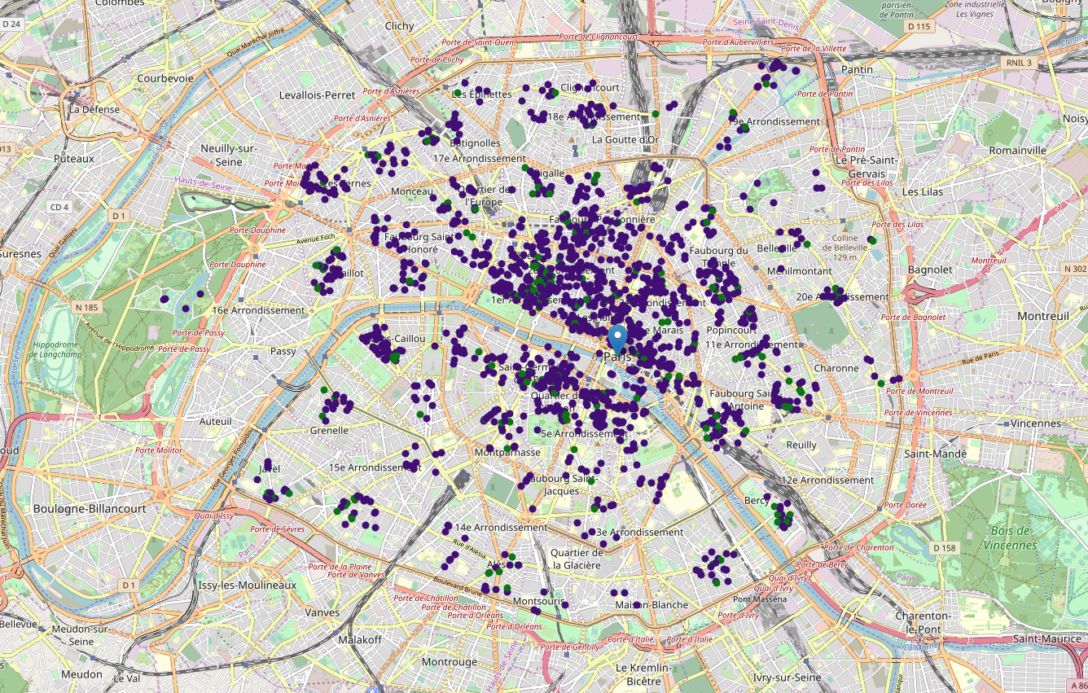
Exploratory Data Analysis

Slide 5

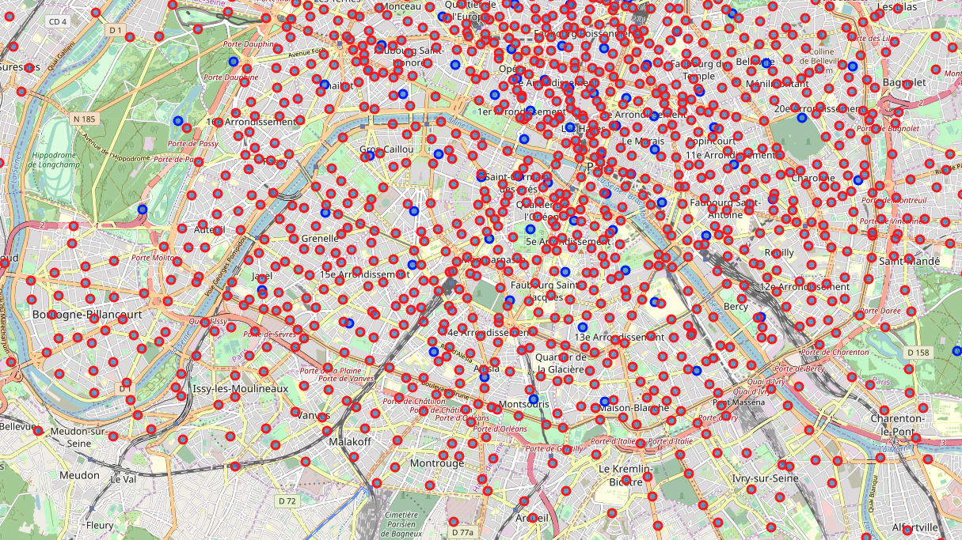



Exploratory Data Analysis

Slide 6
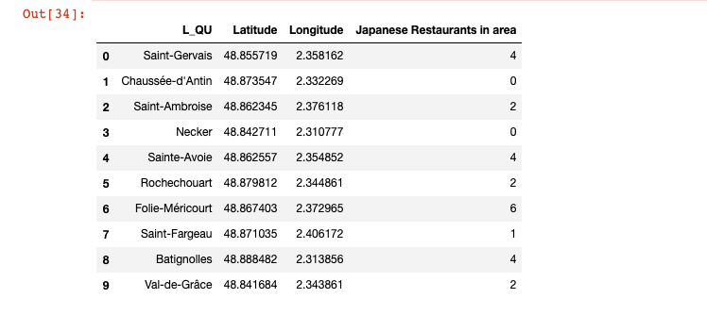
Exploratory Data Analysis

Slide 7
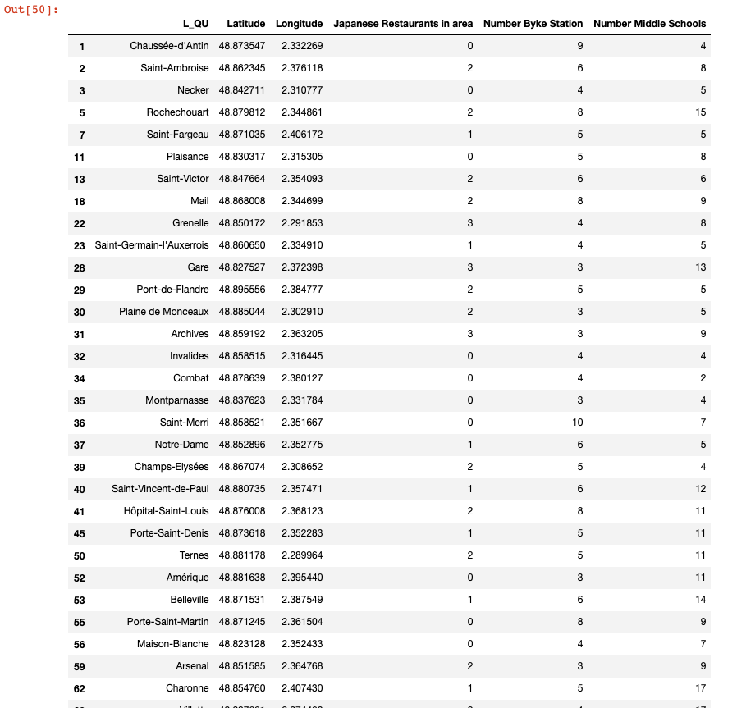
Exploratory Data Analysis

Slide 8
Methodologiy
In this project we will direct our efforts on detecting areas of Paris that have low japaneses restaurant density (< 5), close to two middle school at least and close to one bike station at least. Given a neighborhood, we will limit our analysis to area ~1km around neighborhood center.
In first step we have collected the required data: location and type (category) of every restaurant within Paris, middle school in Paris and bike station in Paris. We have also identified Japanese restaurants (according to Foursquare categorization).
Second step in our analysis will be calculation and exploration,
number of Japanese restaurants in 1km arround the center each neighborhood.
number of middle school in 1km arround the center each neighborhood.
number of bike station in 1km arround the center each neighborhood
In third and final step we will focus on most promising areas and within those create clusters of locations that meet some basic requirements established in discussion with stakeholders: we will take into consideration locations with no more than two restaurants in radius of 250 meters, and we want locations without Japanese restaurants in radius of 400 meters. We will present map of all such locations but also create clusters (using k-means clustering) of those locations to identify general zones / neighborhoods / addresses which should be a starting point for final 'street level' exploration and search for optimal venue location by stakeholders.

Slide 9
Results and Discussion
Our analysis shows us a very high number of restaurants in Paris and a very high concentration of Japanese restaurant in the center of Paris. We then focused on the outermost neighborhoods while staying in Paris. We held the neighborhoods with a low number of Japanese restaurants (<= 3), a large number of bike stations (> = 3) and with a number of colleges also raised to give more chance to our future Japanese restaurant.
First of all, we retrieved all the data on a site set up by the city of Paris (data are available for free). We then proceeded to a data processing before retrieving the list of restaurants (especially Japanese restaurants) with foursquare. The data collected on bike stations and schools, also allowed us to make an aggregation to determine the optimal location for our next restaurant.
Result of all this is 40 zones containing largest number of potential new restaurant locations based on number of and distance to existing japanese restaurant - both restaurants in general and Japanese restaurants particularly. This, of course, does not imply that those zones are actually optimal locations for a new restaurant! Purpose of this analysis was to only provide info on neighborhoods in Paris it is entirely possible that there is a very good reason for small number of restaurants in any of those neighborhoods, reasons which would make them unsuitable for a new restaurant regardless of lack of competition in the area. Recommended zones should therefore be considered only as a starting point for more detailed analysis which could eventually result in location which has not only no nearby competition but also other factors taken into account and all other relevant conditions met

Slide 10
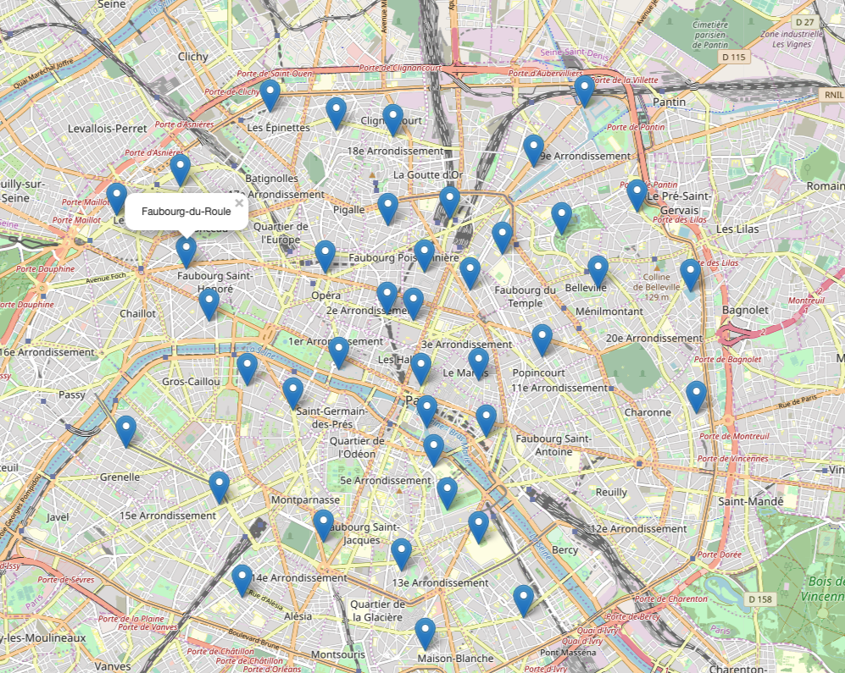
Results and Discussion

Slide 11
Conclusion
Purpose of this project was to identify Paris neighborhood close to 2 middle school at least, close to 3 bike station at least and with low number of japanese restaurants in order to aid stakeholders in narrowing down the search for optimal location for a new Japanese restaurant. By calculating restaurant density distribution from Foursquare data we have first identified general neighborhood that justify further analysis (external of Paris), and then generated extensive collection of locations which satisfy some basic requirements. Clustering of those locations was then performed in order to create major zones of interest (containing greatest number of potential locations) and addresses of those zone centers were created to be used as starting points for final exploration by stakeholders.
Final decission on optimal restaurant location will be made by stakeholders based on specific characteristics of neighborhoods and locations in every recommended zone, taking into consideration additional factors like attractiveness of each location (proximity to park or water), levels of noise / proximity to major roads, real estate availability, prices, social and economic dynamics of every neighborhood etc.

